Slide 1
Science – Animal Husbandry
Year 9 and/or 10

Slide 2
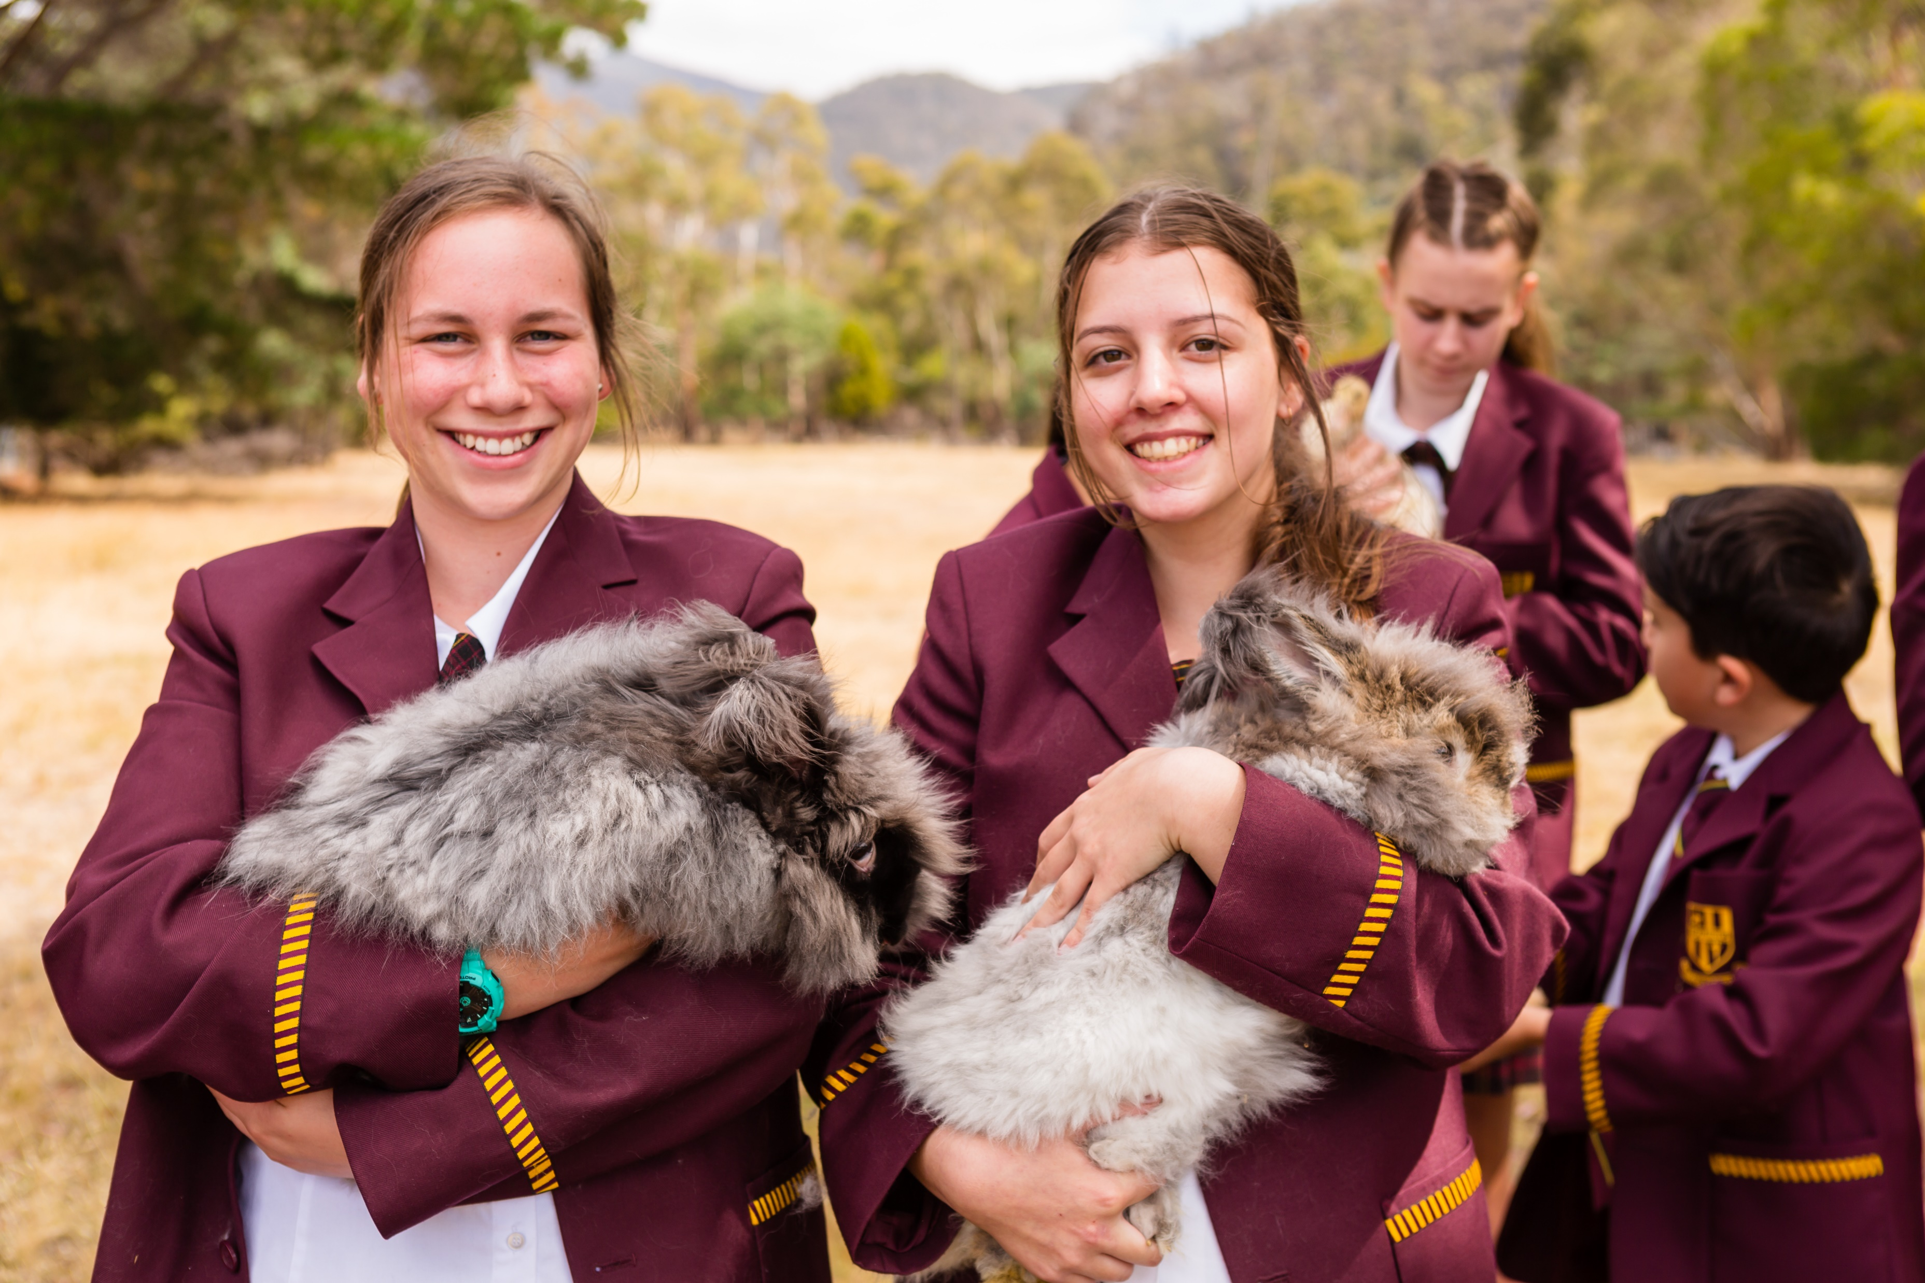
Animal Husbandry
Animal Husbandry is a 2 year course that is intended to engage and extend students interested caring for animals.

Slide 3
Animal Husbandry Careers
Farm Manager
Research Assistant
Entrepreneur
Animal Husbandry Technician
Subject Matter Specialist
Post Graduate Teacher
Animal Husbandry Officer
Employment Area
Stud farms
Poultry Farms
Rabbit farms
Veterinary Hospitals
Wildlife Sanctuaries
Animal Husbandry Clinics
Aviaries
Zoological parks
Dairy farms
Universities

Slide 4
Topics Covered
Learn to care for the health of any type of animal and understand the scope of services offered by animal care services, including in veterinary practices.
Learn to assess animal health, explain a variety of conditions and identify appropriate treatments or responses to a range of more common complaints or illnesses.
Develop a sound foundation knowledge of animal anatomy and physiology as a basis to understanding the care and management of animals.

Slide 5
Engaging Activities
Students will be introduced to a wide variety of practical activities in the classroom.
Students will be allowed to participate in the Life Science Marine Camp at Woodbridge where they will engage with the work of biologists.
Students will take part in the Festival of Bright Ideas.

Slide 6
Find out more…
Please feel free to contact Ms. Jane Myres, Coordinator of Science, at foleary@dominic.tas.edu.au

